Slide 1


Fungal biotransformation
Taylor Hedley

Slide 2

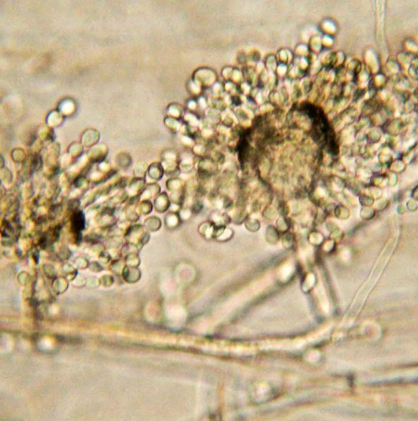
What is it?
Biotransformation/bioremediation are umbrella terms for the process of plants, microbes, or fungi cleaning up harmful substances in the environment by breaking them down.

Slide 3
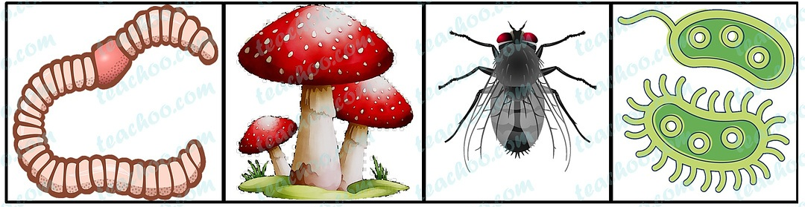
Can all plants, microbes, or fungi be used?
What are decomposers?
Decomposers are classified by their ability to break down dead organisms into smaller particles and create new compounds.

Slide 4
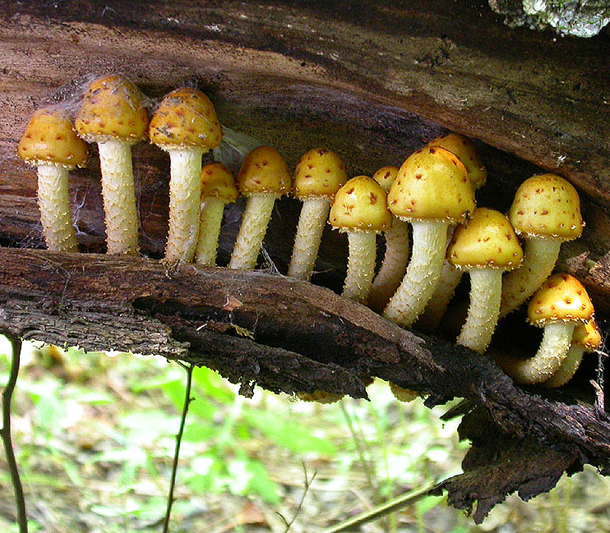

Okay but why fungi?
While there are several living organisms across all domains of life that are capable of this process, fungi are the most promising due to their unique metabolic capabilities. Their intra and extracellular enzymatic machinery and their ability to excrete acids allow fungi to attack and metabolize a wide range of compound classes comprising inorganic and organic pollutants.
Fungi have one of the most diverse phyla with a total number of species estimated to range between 2 to 4 million.
Fungi are chemoheterotrophs, which means they use organic chemical substances as their energy source.
They’re also pretty dang cheap..

Slide 5
How does it work?
Fungi secrete enzymes such as ligninases, cellulases, and peroxidases, which can degrade complex organic polymers.
The easiest part of the landfill to treat is landfill leachate, which is produced by the seeping of liquids through landfilled waste.
Coagulation and flocculation are widely used as a pretreatment, in order to remove the non biodegradable organic matter.
Are we just throwing mushrooms into landfills?
The waste can be treated by being removed from the landfill and treated with the fungus in a lab. This is referred to as ex-situ.
The waste can be treated on site with the fungus which is referred to as in-situ.

Slide 6
Why is this helpful?
The landfills are overflowing.
Greenhouse gasses
Landfills are only getting fuller and the waste is getting more complex. We are producing waste at an alarming rate and it’s taking longer to degrade. Adding dyes and plastics
Landfills are the third largest source of human related methane emissions in the United States. Fungi have recently been shown to increase the performance of biofiltration in removing hydrophobic compounds like methane.
Heavy metal is only a good thing when it comes to music.
Reduced waste transportation
Heavy metal contamination is widespread and can even be transferred up the food chain to humans. They are not biodegradable, but fungi are able to release organic acids that increase the solubility of heavy metals which releases them from the sediments.
Mycoremediation can be done on site, which eliminates the need for removing the waste and treating it in a separate location.

Slide 7
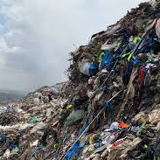
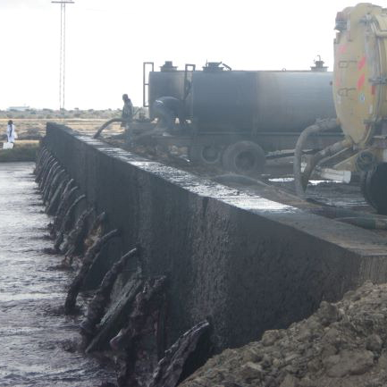
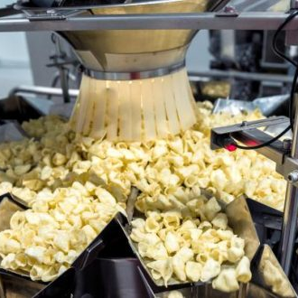
Where are we actually doing this?
Textile industries
Olive milling industries
Food processing industries
Fungus has proven to be more successful than bacteria at removing the dyes and being able to break down the synthetic material that has been incorporated into modern textiles.
Phenolic compounds present in olive mill wastewater are similar to those derived from lignin degradation, making fungi an excellent candidate for treating olive milling wastewater.
Fungi is used to break down the organic material that is present in the waste water of various potato plants such as potato chips or starch processing.

Slide 8

Sounds too good to be true..
Challenges to consider:
Fungi can be sensitive to the environment
Inconsistent waste composition
Slow degradation rates
Disruption of ecosystems

Slide 9

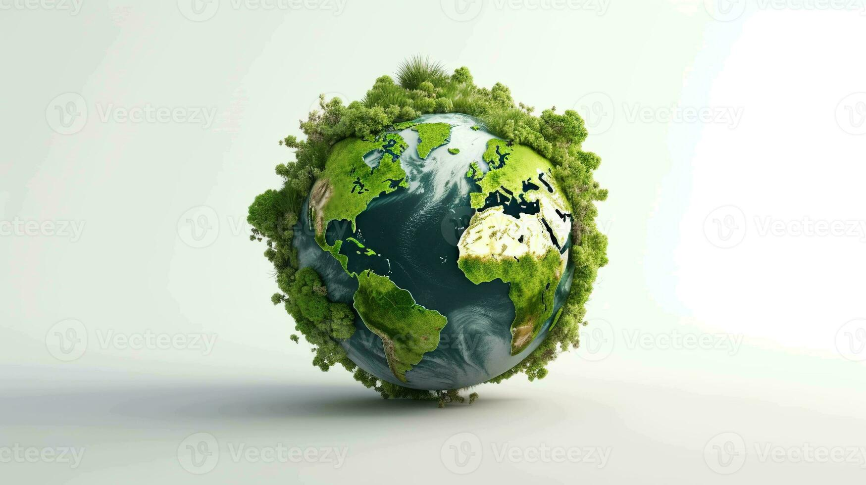

What can the future look like?
Biofuels
Greener earth
Still so much work to be done
Anaerobic fungi have promising potential for application in biofuel production processes due their ability convert biomass to ethanol

Slide 10

Exam style question
Evaluate the challenges or limitations associated with using fungi for large-scale bioremediation in landfills.

Slide 11
Sources
https://www.frontiersin.org/journals/marine-science/articles/10.3389/fmars.2023.1070905/full
https://blog.mdpi.com/2023/12/12/fungi-for-waste-management/#:~:text=Fungi%20achieve%20this%20by%20releasing,fungi%20only%20lowered%20their%20effectiveness.
Sara Cantera, D. Katerine Banda, Roxana Ángeles-Torres, Paul G. Palmay, Raquel Lebrero,Assessing macroscopic and microscopic performance of fungal-based biofilters for methane abatement, Environmental Technology & Innovation,Volume 33, 2024, 103519, ISSN 2352-1864, https://doi.org/10.1016/j.eti.2023.103519. (https://www.sciencedirect.com/science/article/pii/S2352186423005151)
https://www.intechopen.com/chapters/49070

Slide 12
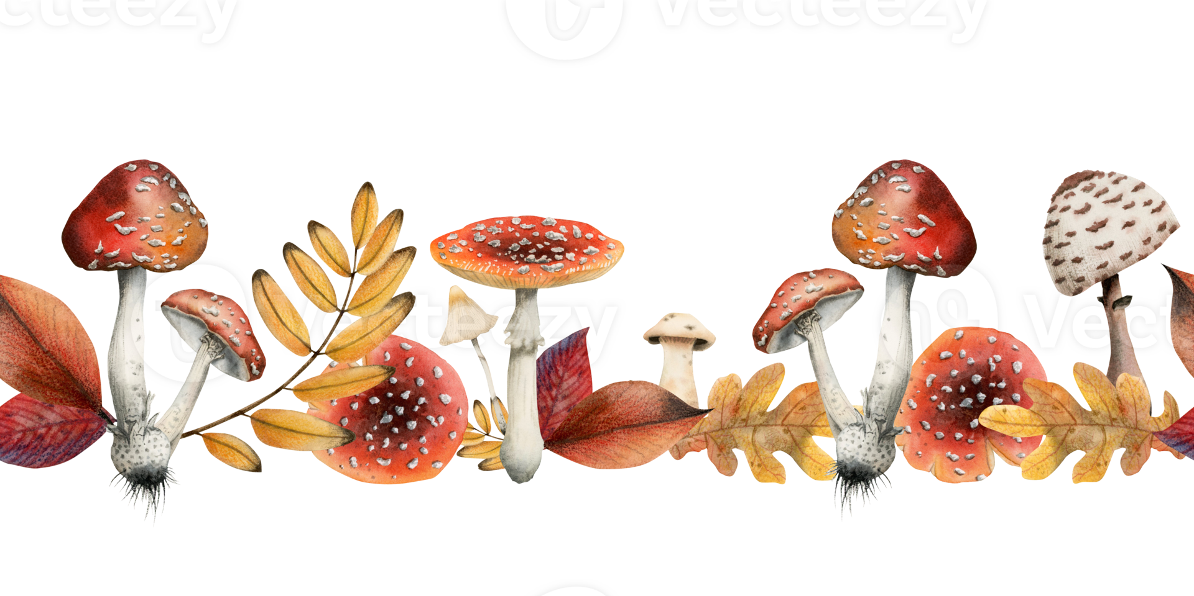
Questions?

